Slide 1


FoodFirst Inc.
Project by Adeladun MOA

Slide 2
Table of Content
Introduction
As it is
Add on
Our Team
Elicitation
User story mapping
User stories
Relevant activities post-elicitation
Events and Ceremonies
Jira boards (1-12) showing processes
Jira boards (13-16) showing reports
Centalised ordering Mgt.(image)
Project Development and outcome in images
Thank you.

Slide 3
Introduction
FoodFirst Inc. is a food Company that offers menued items to working class Customers
They have 8 locations around the City where they sell to work-in Customers.
However in view of increasing competition and the dynamics of the economy, Customers’ demand and the urge to drive revenue, they have decided to venture into food delivery services.
This will require a functional website, accommodate an online application for smartphones and computers to facilitate ordering and delivery via dispatch riders (partnership or company owned).

Slide 4

As It Is
Project scope
Project Problems
To Manage the process of developing a food delivery service to working class customers.
Process improvement and development to incorporate food delivery services for increased patronage.
FoodFirst has stores in only 8 locations across the City.
Increasing competition and shrinking customer base.
Limited branch network- They would like to start a up food delivery services to reach out to more customers.

Slide 5

Add on
Aims
Objectives
To develop a functional website ,a smartphone app and designated lines where customers can place orders in order:
To increase market share and coverage.
To increase Company's profitability.
To increase Customer satisfaction.
Have a functional Website
Have a smartphone app that works for ordering.
Payment integration.
Efficient delivery services
Feedbacks

Slide 6



Our Team
Takuma Hayashi
Noa Bill
Dayo Nuel
Jenny Etta
BA;PO
Head IT/Tech team
Scrum Master
BO

Slide 7
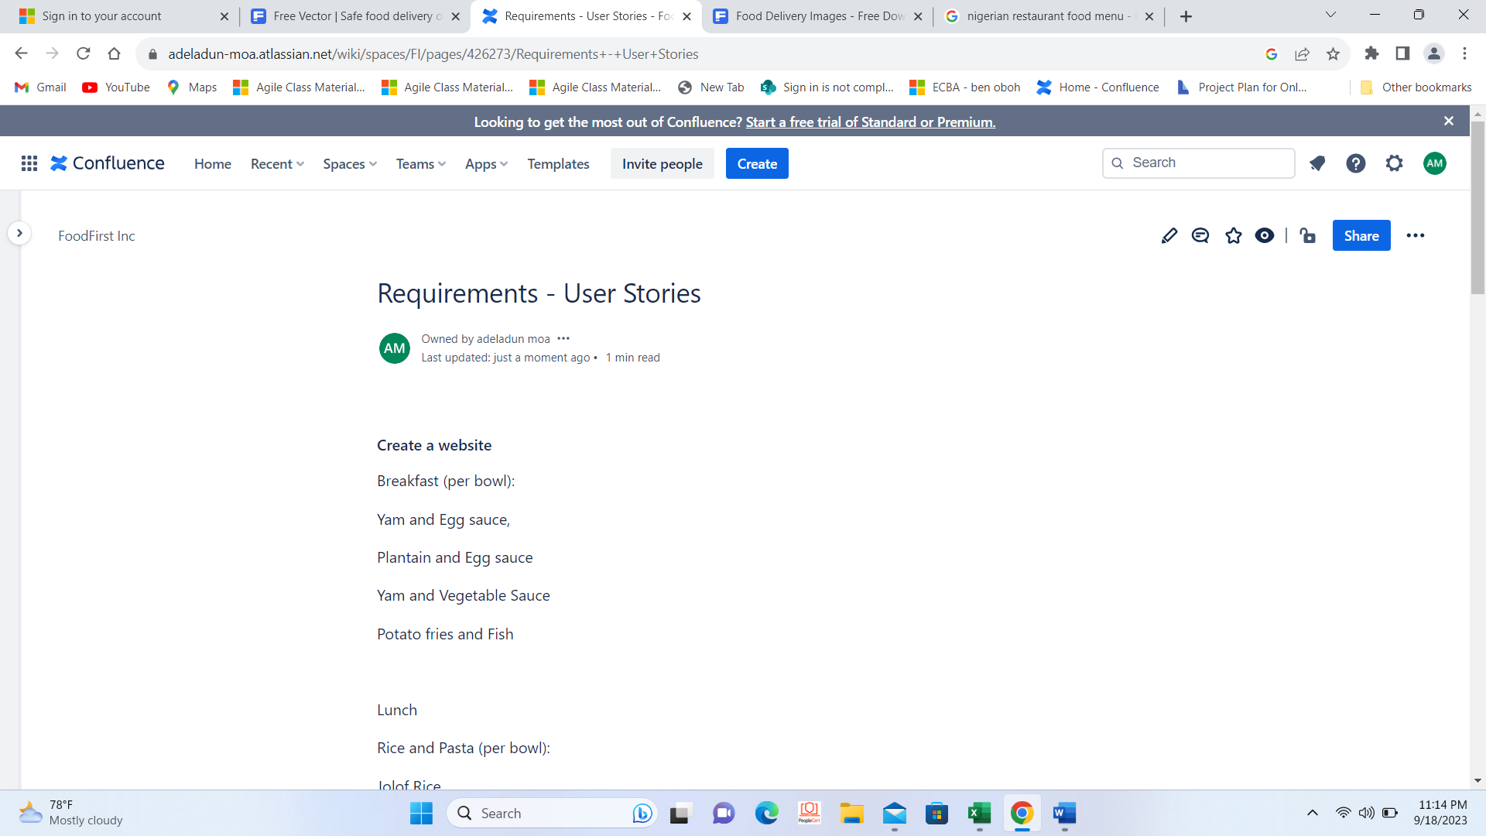
Elicitation
This is a very importance exercise, we had sessions (questions and answers, deliberations} with the BO and relevant stakeholders to ensure that what is to be accomplished fits into the system.
We discussed the current state of FoodFirst Inc., processes in their operation, expectations from the proposed food delivery business, available facilities and limitations e.t.c.
We came up with itemised requirements.

Slide 8
User Story Mapping
FoodFirst Inc story mapping (1) (2).xlsx

Slide 9
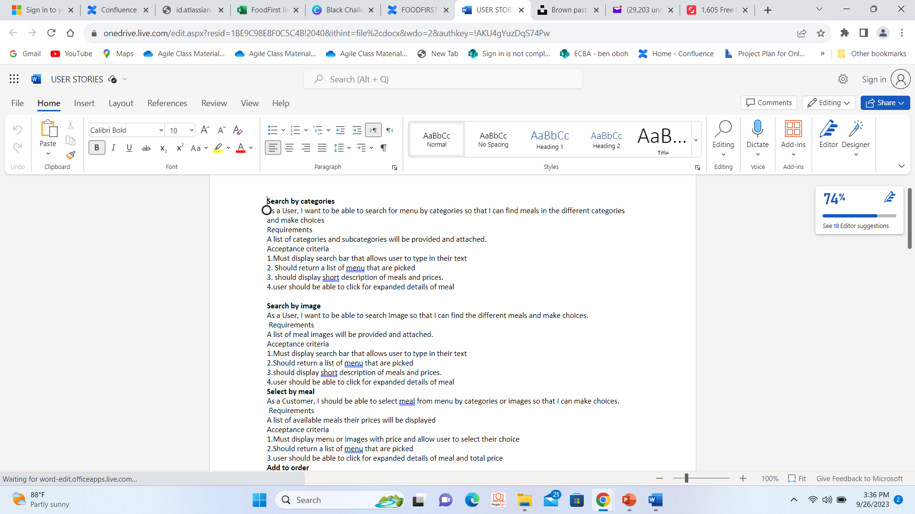
User Stories

Slide 10



Relevant Activities Post Elicitation
After elicitation ,the major activities called the Epics are broken down into tasks , i,.e developing our user story and arrived at backlogs in a process called story Mapping, The backlogs are prioritized in line with items that will be required for the incremental development (iteration).This is a collaborative effort of development team.
The resultant tasks(backlogs) are taken through as unofficial process called refinement by the PO, where we clearly defined them in more detailed term based on current information. We sought approval of BO before we the releases were moved to sprint backlog for iterations.
User stories are developed in line with the requirements and assessment criteria. We used expert judgement and analogous estimation technics. Developers gave a direction for the prioritisations. To achieve MVP. plan begins for the first Sprint. By preparing backlogs ready to be worked on.
We moved to JIRA

Slide 11
EVENTS (ceremonies)
Sprint planning (1hr.45mins)
Daily scrum (15mins/day)
At this meeting with the development team, we defined the task and purpose ,Dev team discussed needs, defined Acceptance criteria and DOD,all conditions clearly laid out.,agreed with the developers on to do list.
This meeting of Dev. team to keep up with task and accomplishment in the ongoing sprint.. Meetings presided on by Nuel (resident scrum master)
Sprint (2 weeks)
Sprint retrospective
Further priorised tasks selected from ready to be worked on backlogs and development begins in the 1st sprint.
Upon completion of each sprint ,we had a meeting to deliberate on our results and activities (well-done, be maintained and to be stopped. Then move to plan the next sprint
Sprint review
Basically this is a demo meeting , user story testing ,inspect ,review test ,checked acceptance criteria and get feedbacks

Slide 12
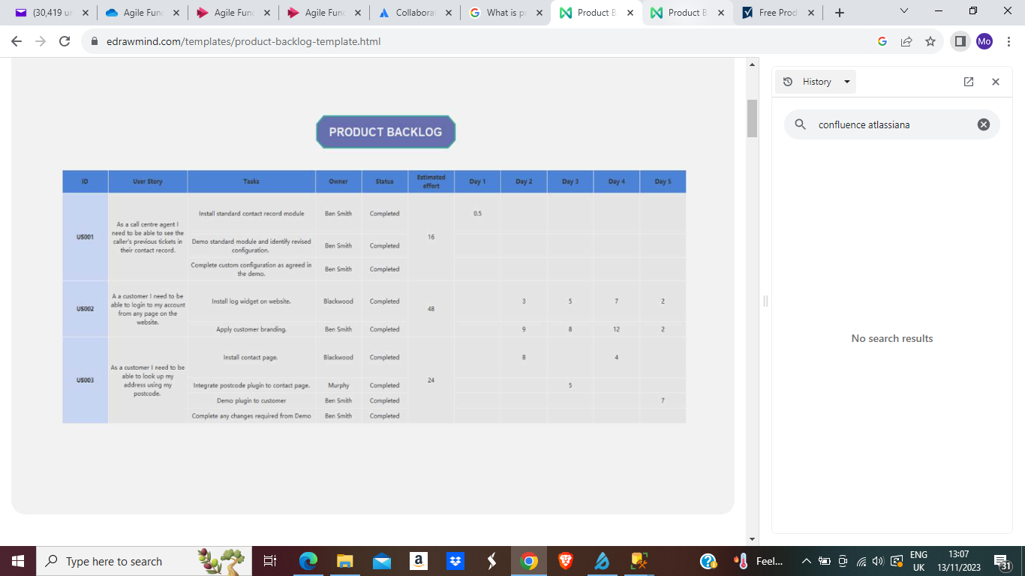
1.Jira board-Sprint ready backlog reflecting versions

Slide 13
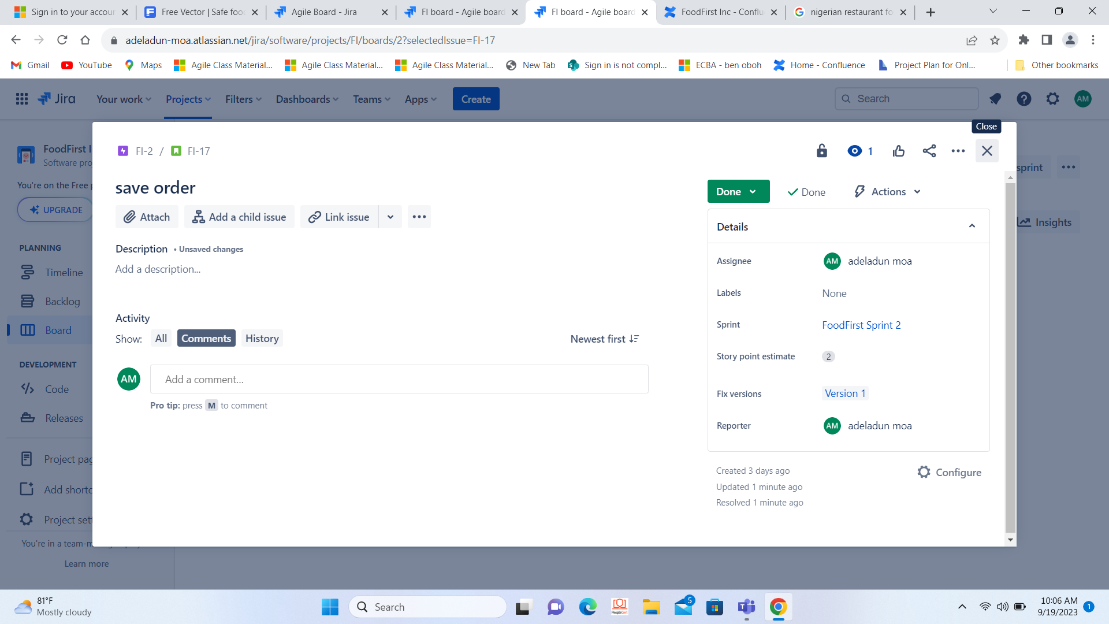
2.Jira board-estimation

Slide 14
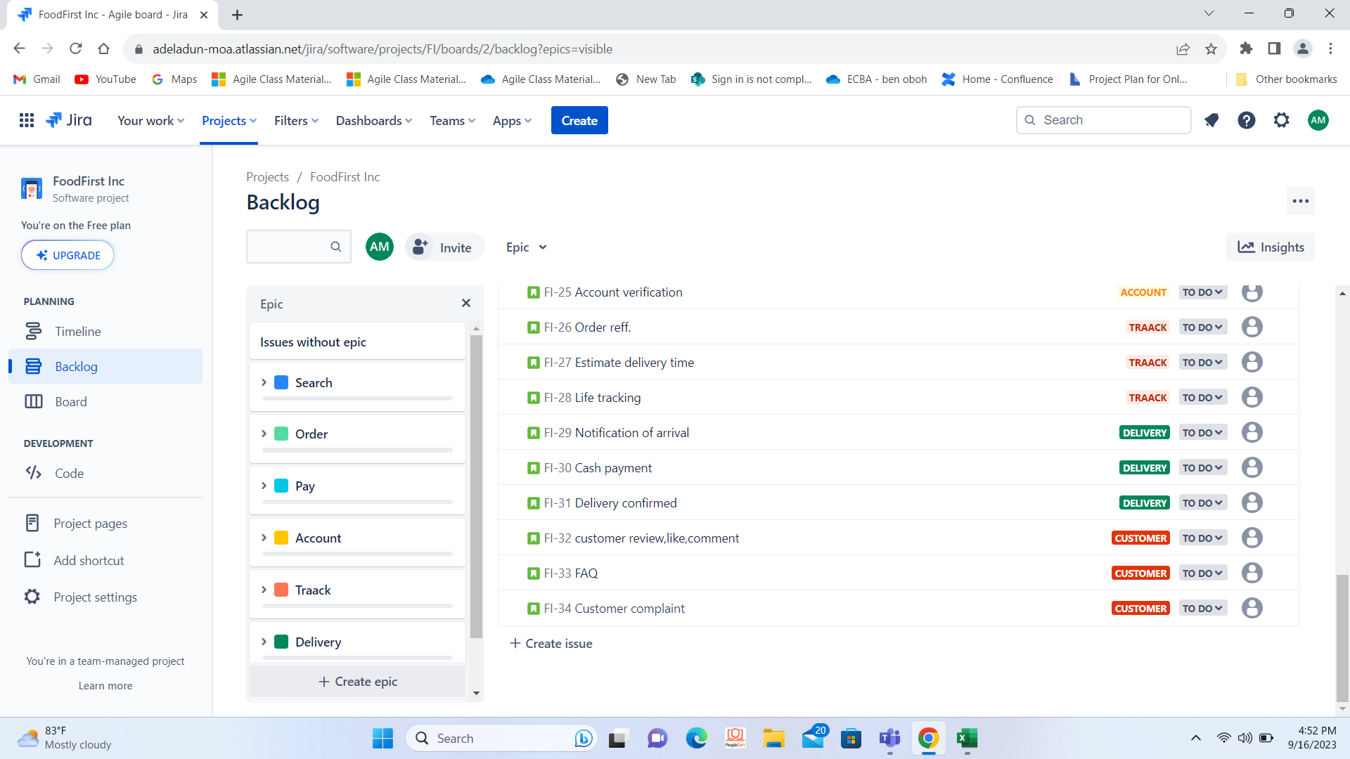
3.Jira board-Epics

Slide 15
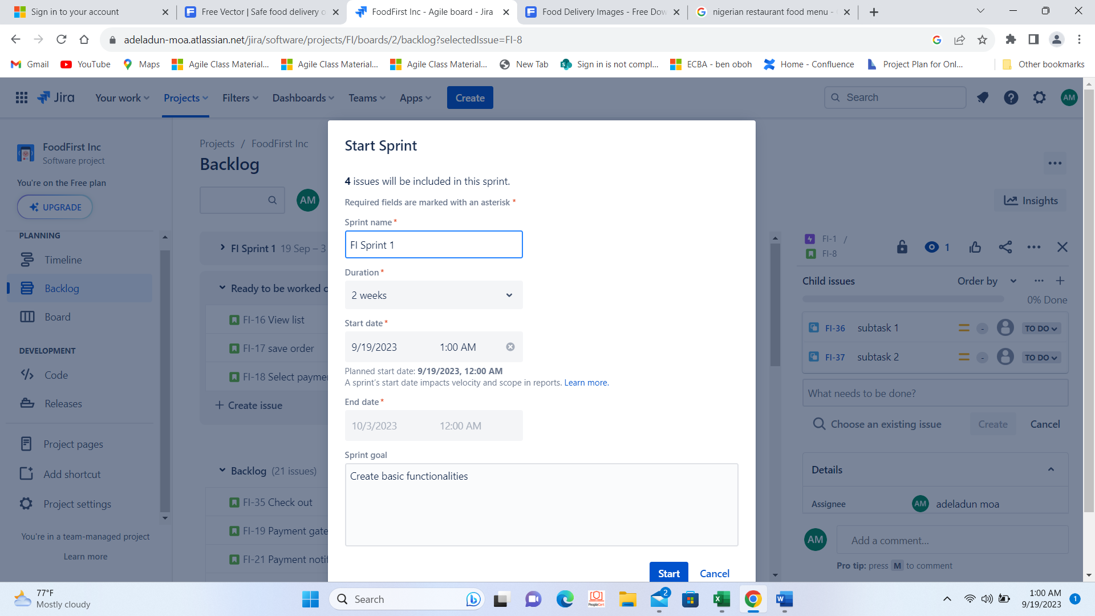
4.Jira board-Sprint commences

Slide 16
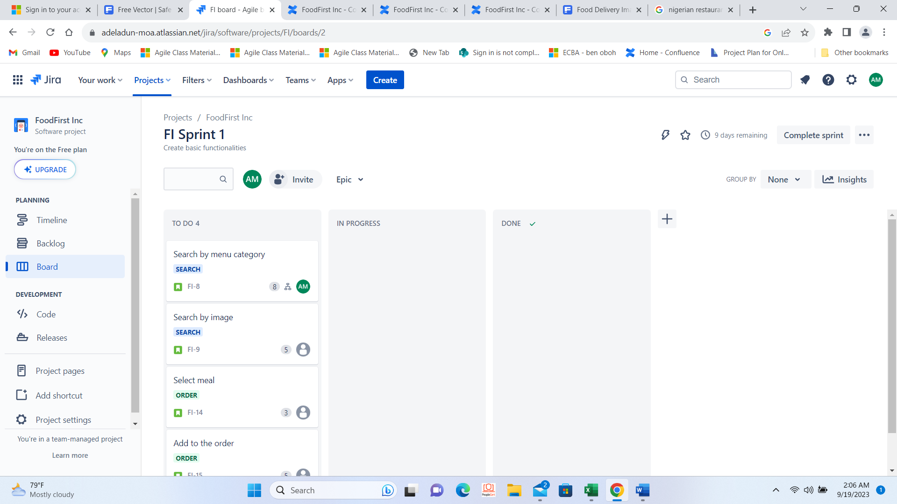
5.Jira board -Sprint in-progress

Slide 17
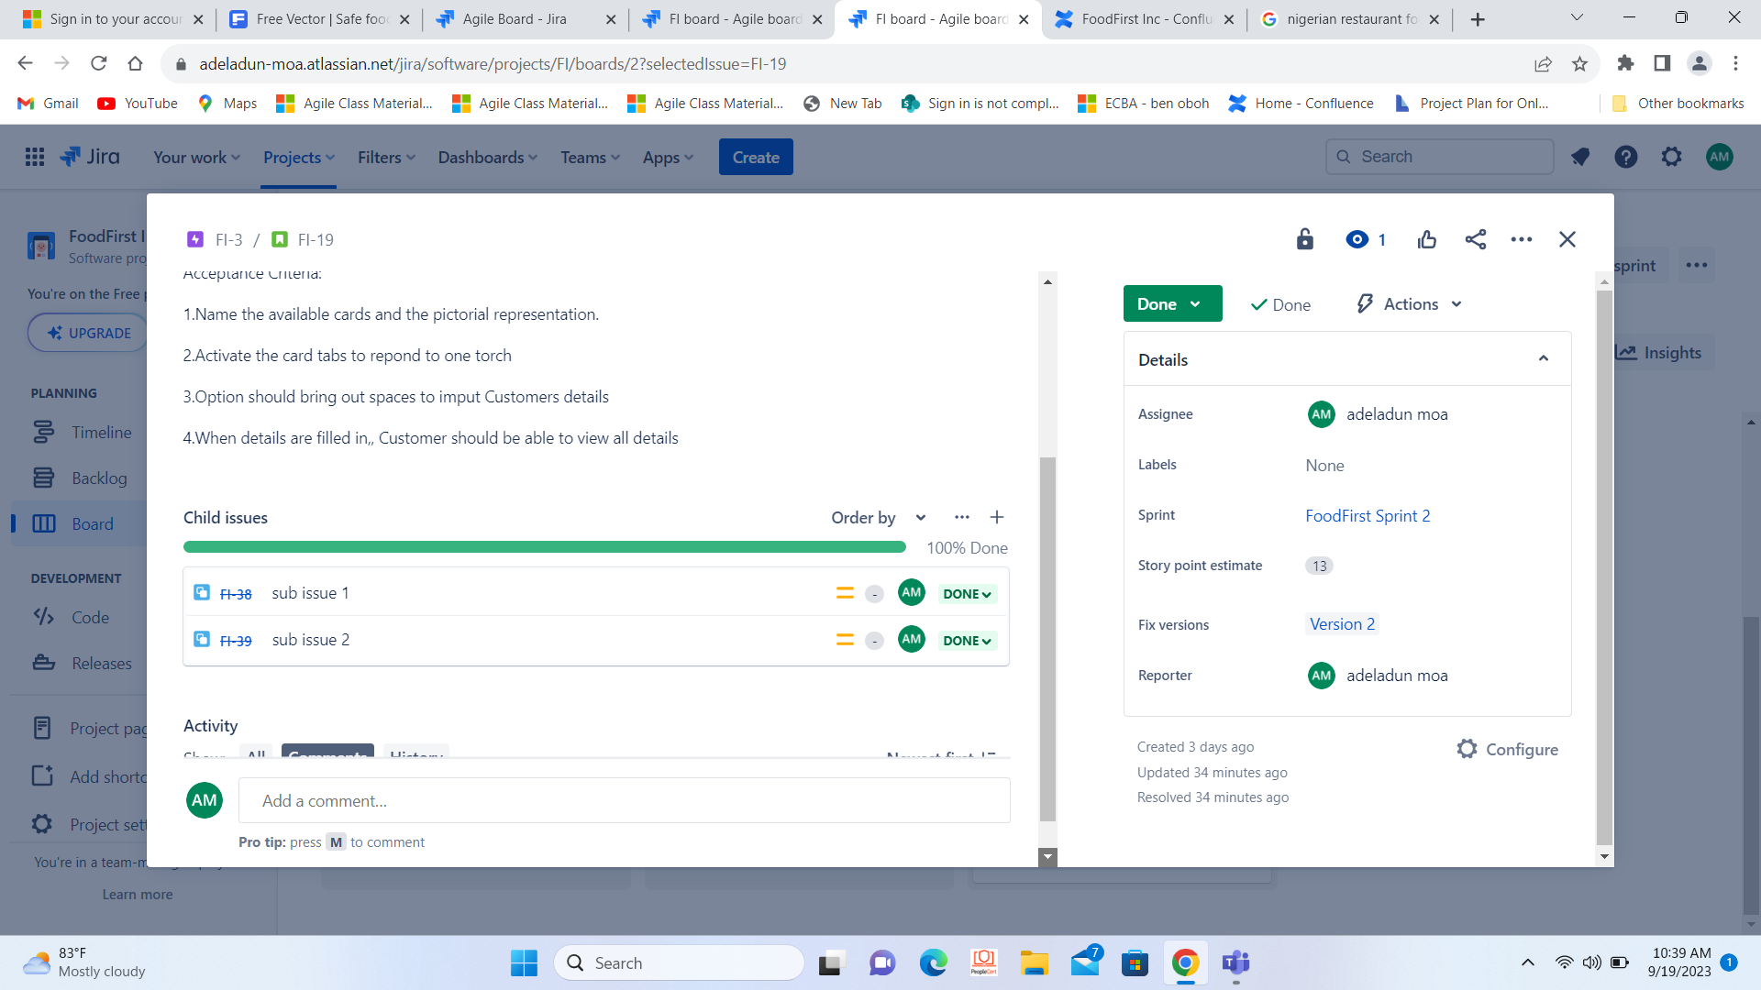
6.Jira board - Sub issues

Slide 18
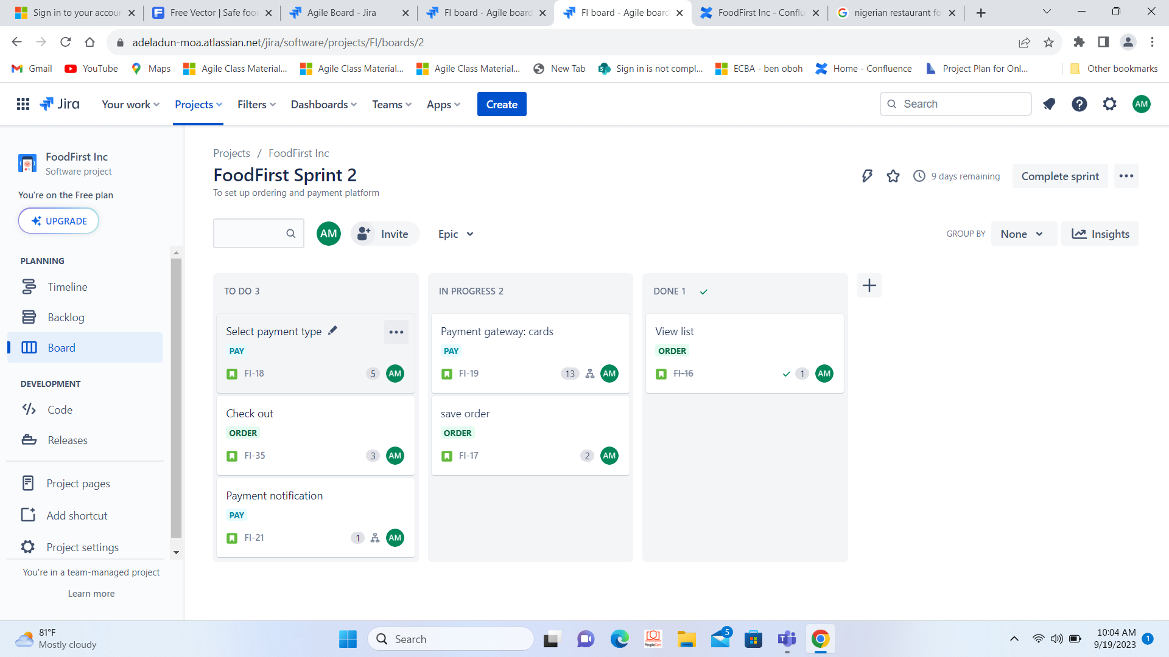
7.Jira board-epics, sprint in-progress and estimates

Slide 19
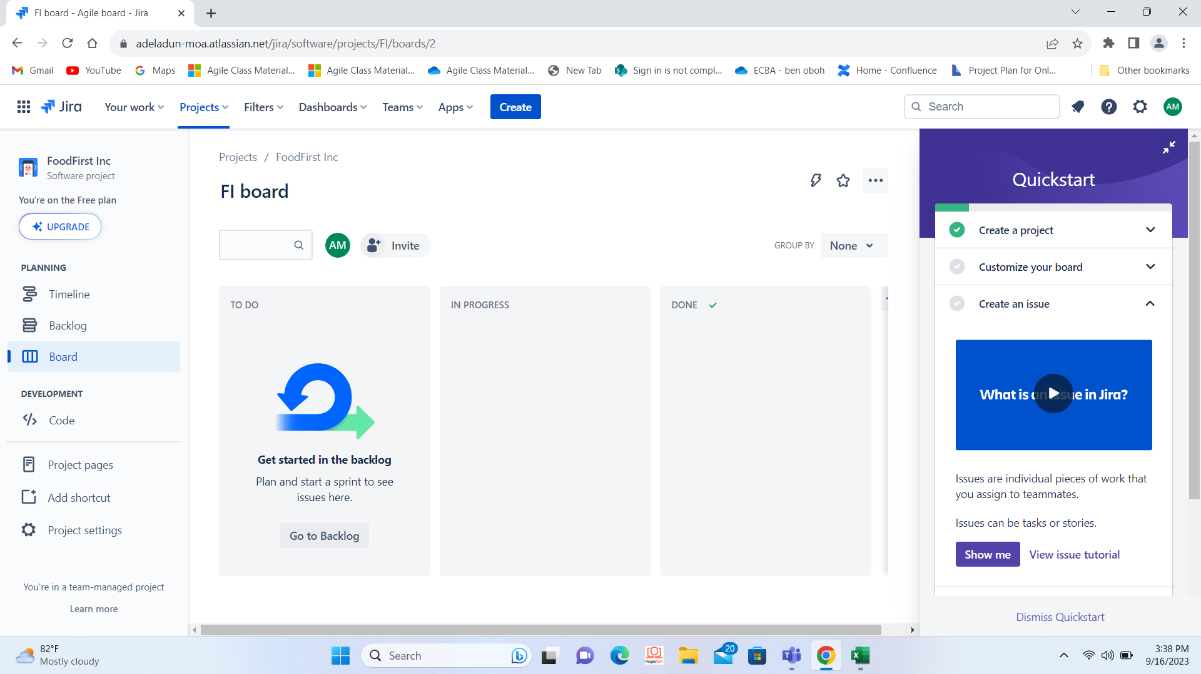
8.Jira board

Slide 20
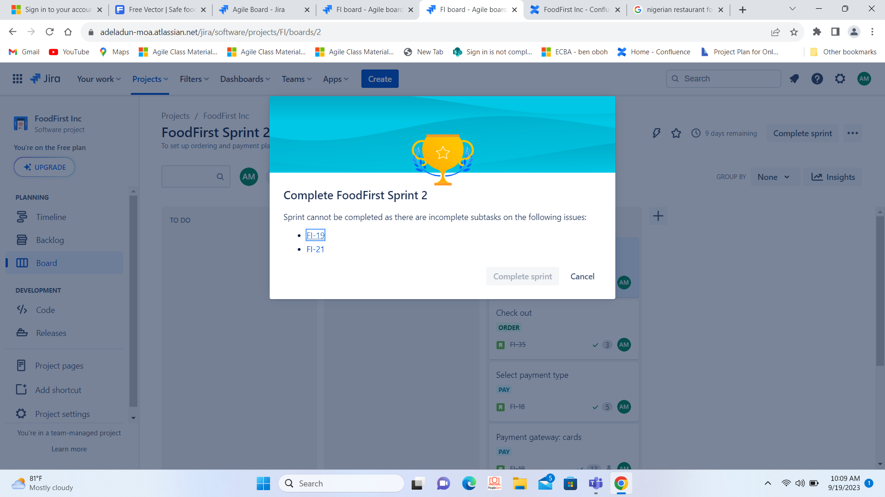
9.Jira board-Completion of sprint

Slide 21
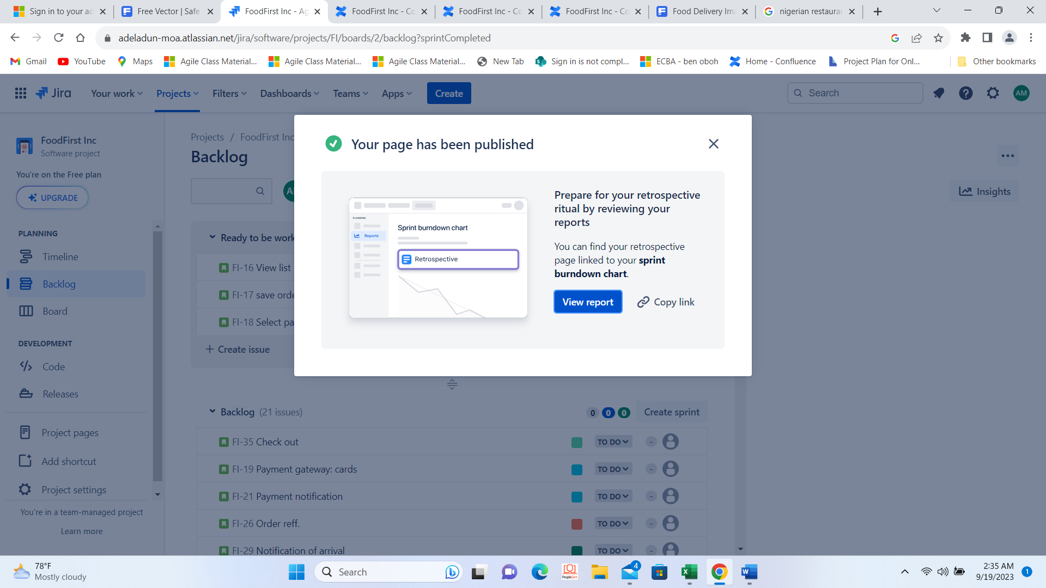
10.Jira board-end of sprint ,to retrospective

Slide 22
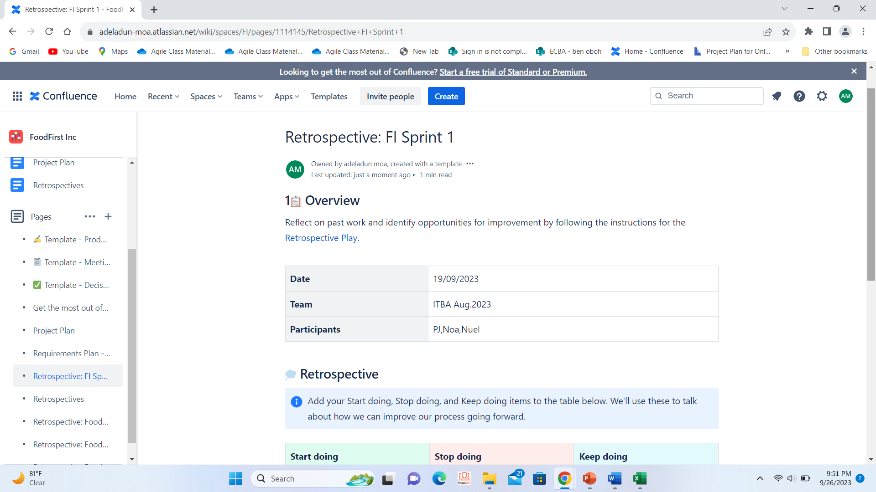
11.Jira board-Retrospective

Slide 23
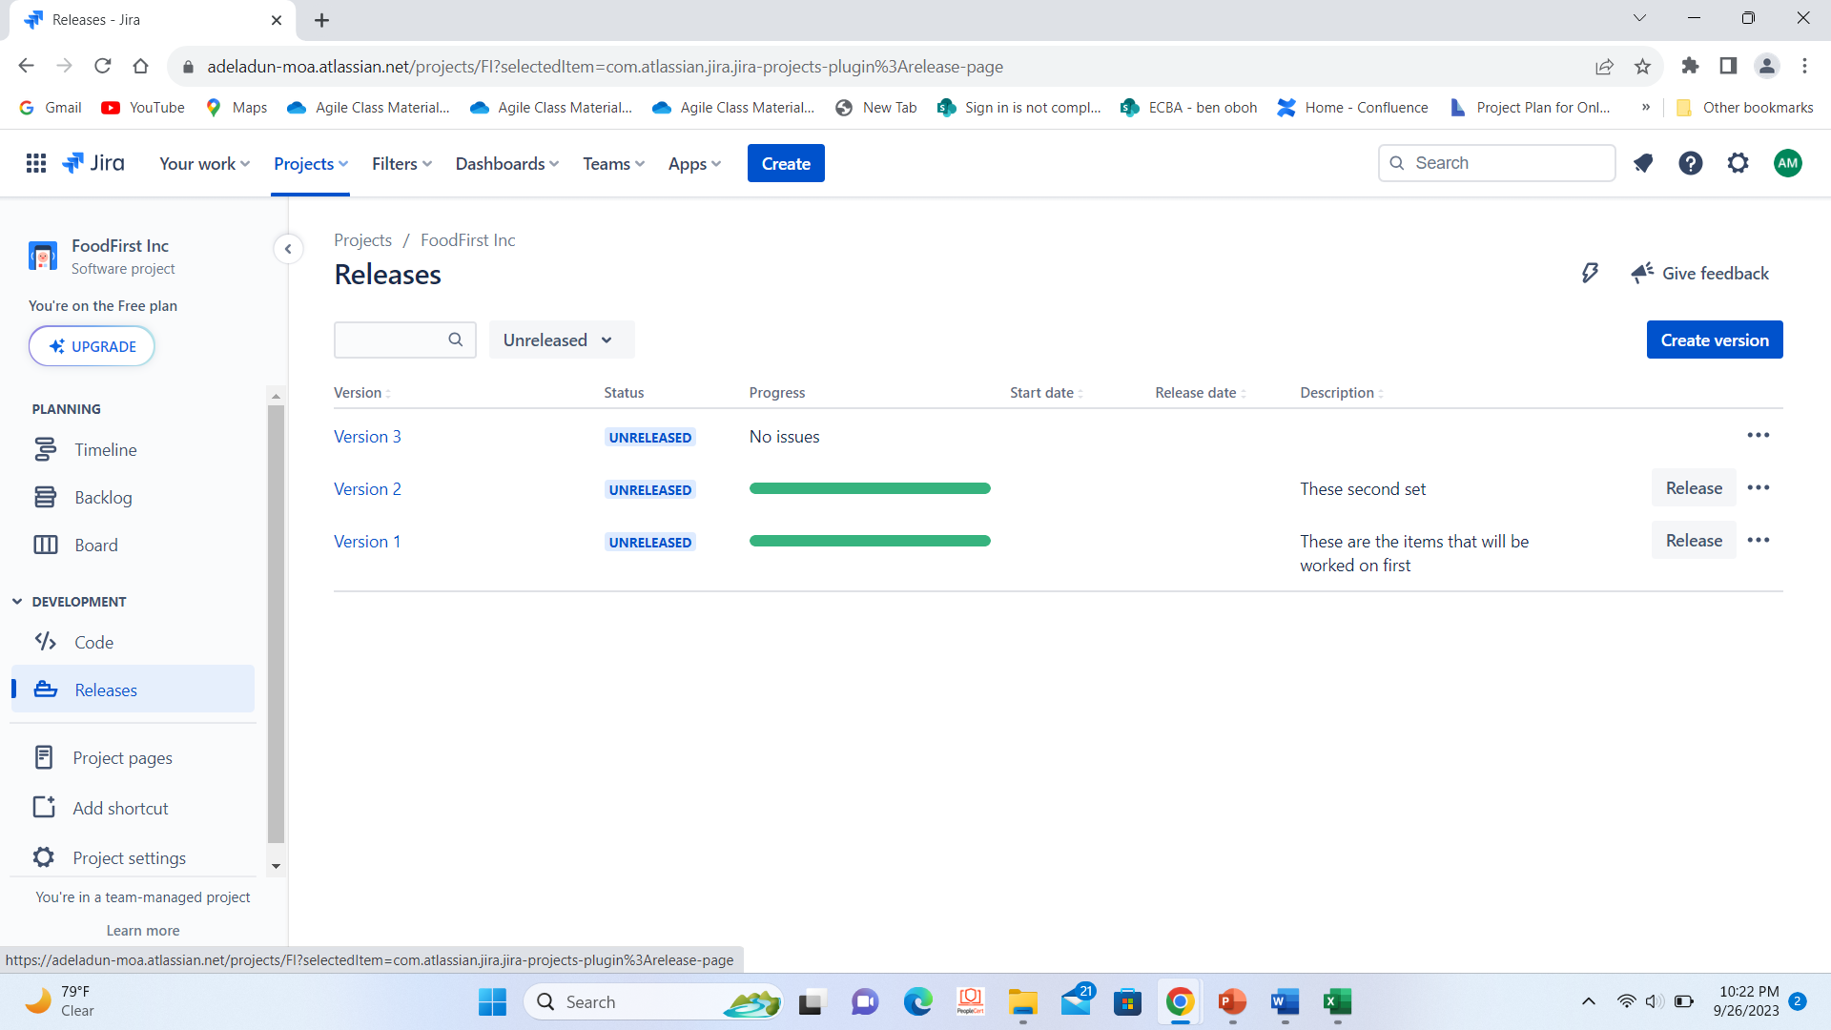
12.Jira board –releases,versions

Slide 24
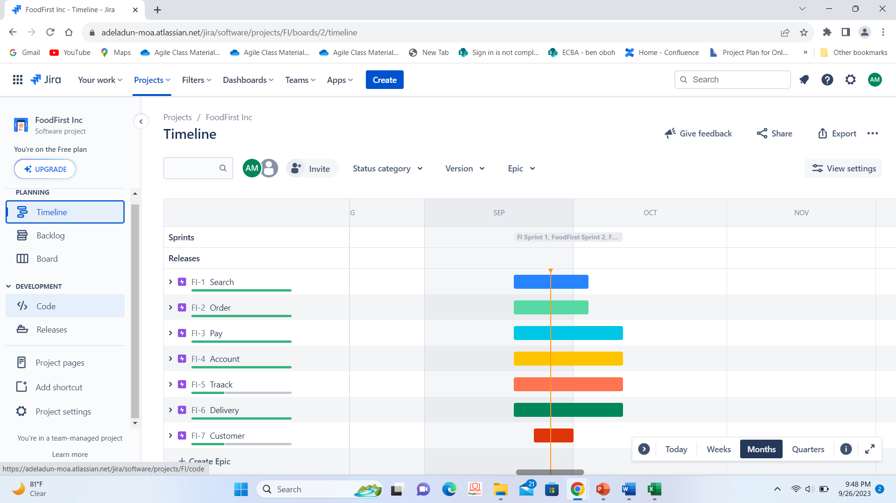
13.Jira board- Time line (report)

Slide 25
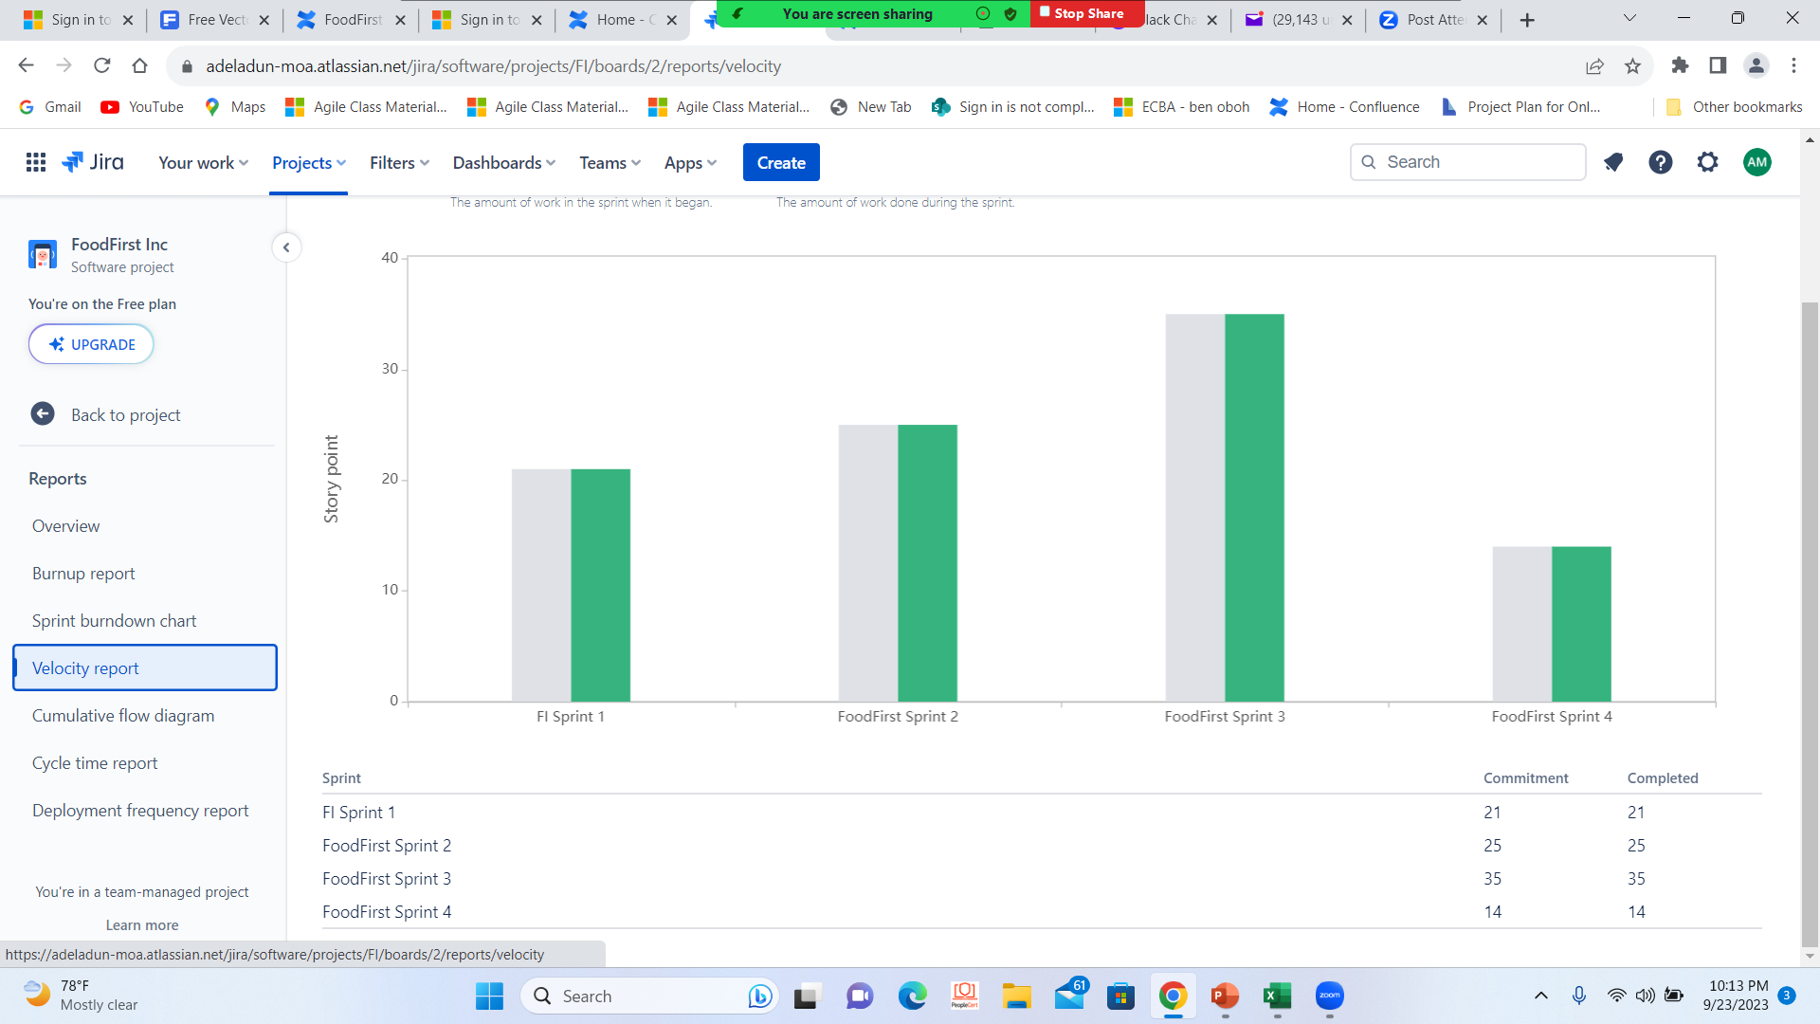
14.Jira board- Team velocity (report)

Slide 26
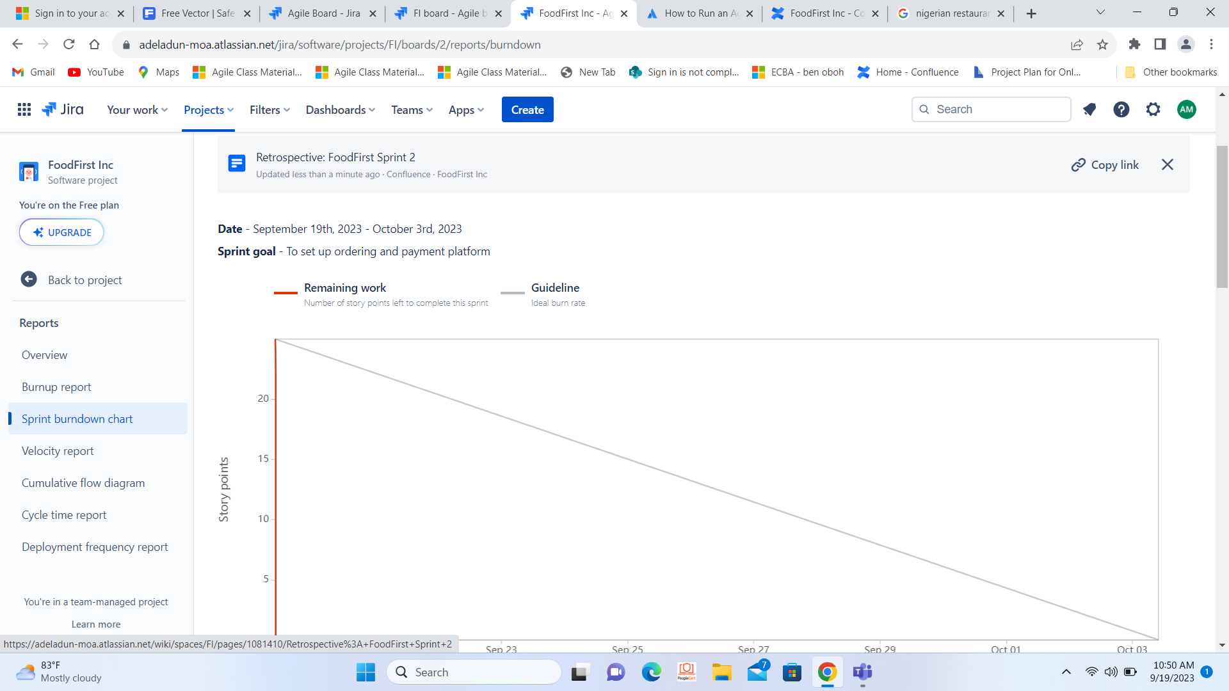
15.Jira board-Burndown chart (report)

Slide 27
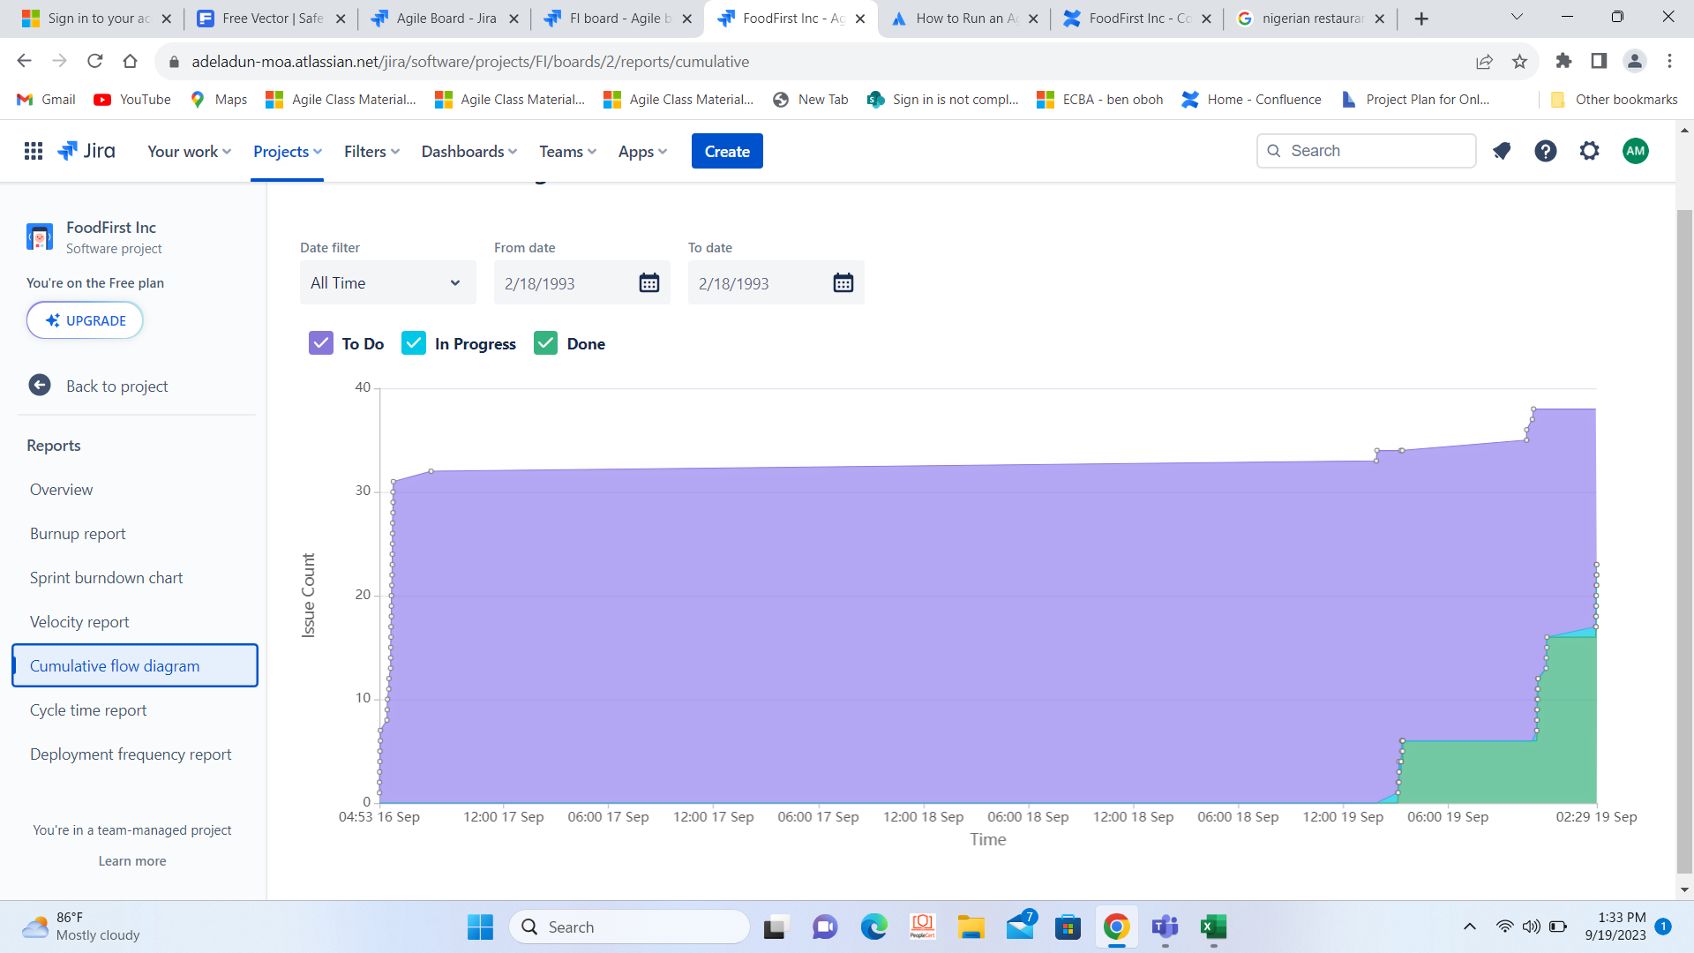
16.Jira board- Cumulative flow diagram (report)

Slide 28


Centralized Ordering Management Unit as recommended

Slide 29



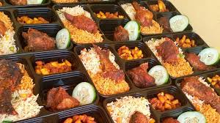

Project development/result in images

Slide 30


Thank you
Mowa
PO/BA
Adeladunmoa@gmail.com

